Slide 1
Introduction to Data Science Using Python
Siddhartha Neupane

Slide 2
Course outline
Lecture on Data and Types of data Lecture on Data Science and Data Science Lifecycle Practical Based Introduction to python and installation of Anaconda (Jypyter notebook) Introduction to Numpys, Pandas, MatPlotLib and Seaborn Indexing , arrays and vectors , list in Python Creating DataFrame using python pandas Importing Data from CSV Slicing Data (Rows and Columns) using Python Summarising, Aggregating, and Grouping data in Python Pandas Joining Multiple Datasets using python pandas Data Scraping and Cleaning Exploratory Data analysis using Python Pandas Data Visualisation using Matplotlib Linear Regression in python Project Work : Project Exploratory Data Analysis using data from Kaggle(open topic) (Datasets that will be used : IRIS, GapMinder, MPG, Titanic, Forbes Richest person)

Slide 3

What is Data
Simply stating , Data are facts , statistics and every other information that are collected in a single place for sole purpose of referencing and analysing.
In other words, Data is a set of variables which can be quantitative or qualitative.

Slide 4
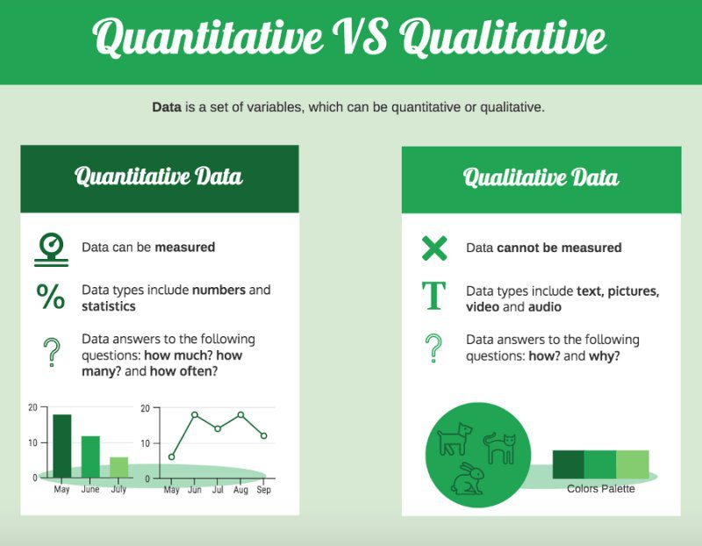

Slide 5
Qualitative Data :
Qualitative data is non-statistical and is typically unstructured or semi-structured. This data isn’t necessarily measured using hard numbers used to develop graphs and charts. Instead, it is categorized based on properties, attributes, labels, and other identifiers.
Qualitative data can be used to ask the question “why.” It is investigative and is often open-ended until further research is conducted. Generating this data from qualitative research is used for theorizations, interpretations, developing hypotheses, and initial understandings.
Qualitative data can be generated through:
Texts and documents
Audio and video recordings
Interview transcripts and focus groups
Observations and notes
Quantitative Data :
Quantitative data is statistical and is typically structured in nature – meaning it is more rigid and defined. This data type is measured using numbers and values, making it a more suitable candidate for data analysis.
Quantitative data can be generated through:
Tests
Experiments
Surveys
Market reports
Metrics

Slide 6
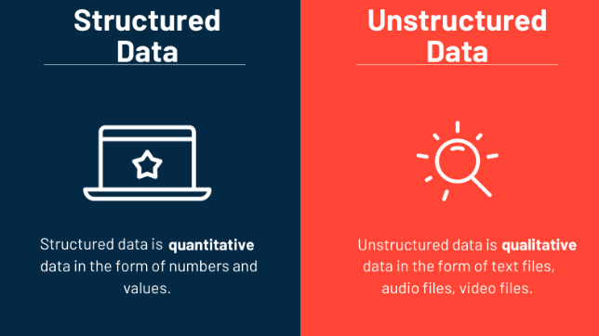
Structured Data Vs Un-Structured Data
What is the difference between structured and unstructured data? Structured data is highly-organized and formatted so that it's easily searchable in relational databases. Unstructured data has no predefined format or organization, making it much more difficult to collect, process, and analyse.

Slide 7
Which data type is better for data analysis?
Qualitative data is unstructured or semi-structured, lacking a defined format, making it challenging to collect and analyze using conventional methods. It often requires additional steps, such as applying metadata or using NoSQL databases, to make sense of this type of data.
2. Quantitative data is structured, organized in a way that allows for easy organization and searchability within relational databases. It typically consists of numerical values, such as those found in spreadsheets, and is well-suited for data analysis due to its inherent structure.
3. Analyzing qualitative data can be time-consuming and expensive, as it often requires in-depth examination, interpretation, and understanding of context. This type of analysis may involve qualitative research methods like coding, thematic analysis, or content analysis.
4.Quantitative data analysis offers the advantage of being more efficient and objective. Statistical techniques can be applied to quantify relationships, patterns, and trends within the data, allowing for a more systematic and rigorous analysis process.
5. Due to its structured nature and the availability of tools and techniques specifically designed for quantitative data analysis, such as statistical software and machine learning algorithms, quantitative data is generally preferred for many types of data analysis tasks. However, the choice of data type depends on the research question, objectives, and the nature of the data itself.

Slide 8
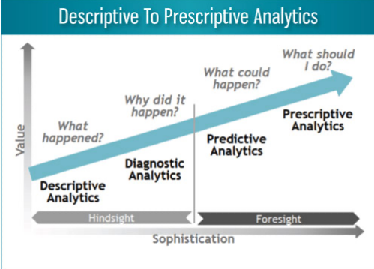
What is Data Science ?
A process of using data to understand things.
• Data tell a story.
• Uncover insights, patterns and trends.
• Transforming data into knowledge that can guide decisions.
• Science (apply the scientific method).
• Observe some phenomenon and record observations (data).
• Explore, formulate hypotheses, build models, make predictions.
• Design experiments to confirm.

Slide 9
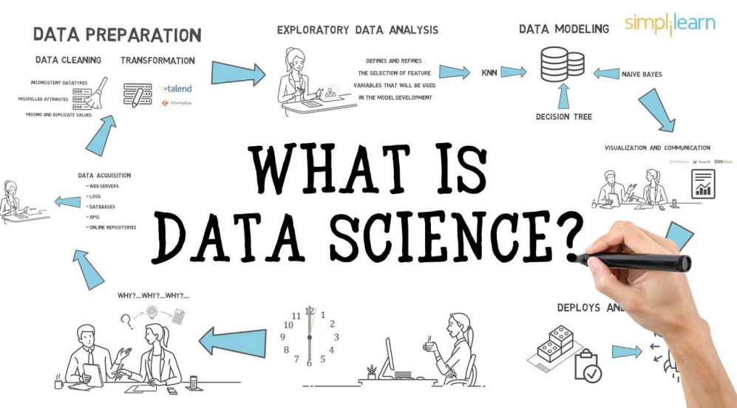

Slide 10
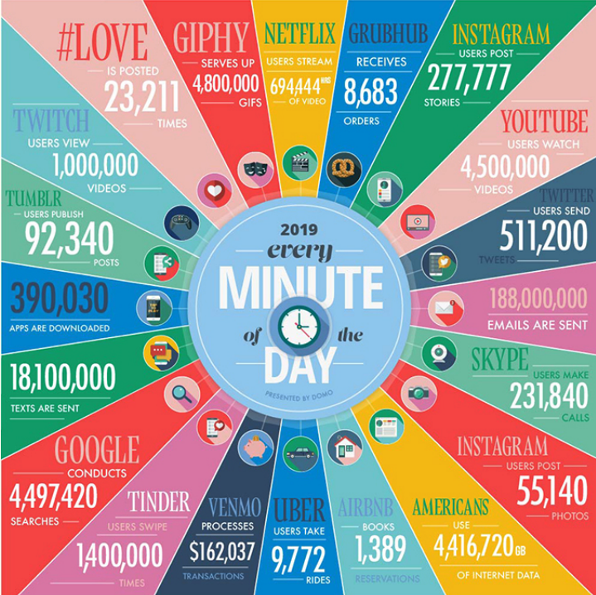
Some Data Science Applications
• “Data is the new oil” — Clive Humby (2006)
• Customer profiling (loyalty cards, fraud detection)
• Recommender systems (Netflix, Amazon)
• Internet search engines (Google)
• Targeted advertising (Facebook)
• Credit scoring
• Healthcare (medical image analysis, genomics)
• Sport (Moneyball – book 2003, film 2011)

Slide 11
Summary
What is Data?
Types of Data
Structured vs Unstructured Data
Paradigms of Data Science
Paradigms of Data Analysis
Some Application of Data Science

